Slide 1
PSO and its variants
Swarm Intelligence Group
Peking University

Slide 2
Outline
Classical and standard PSO
PSO on Benchmark Function
Analysis of PSO_state of art
Analysis of PSO_our idea
variants of PSO_state of art
Our variants of PSO
Applications of PSO

Slide 3


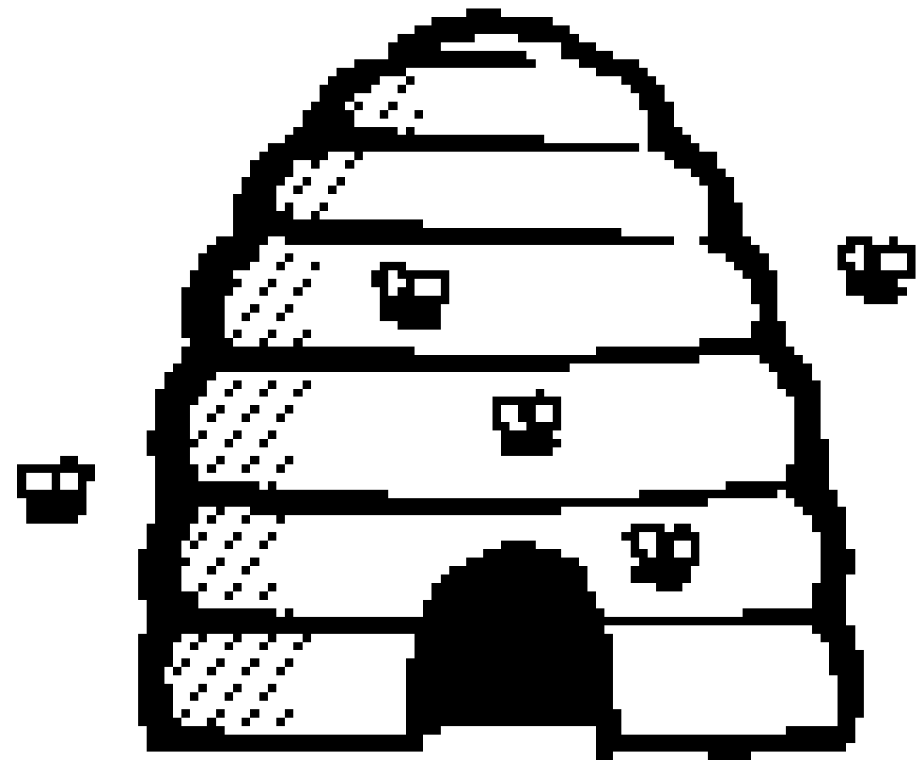



Classical and standard PSO
Swarm is better than personal

Slide 4

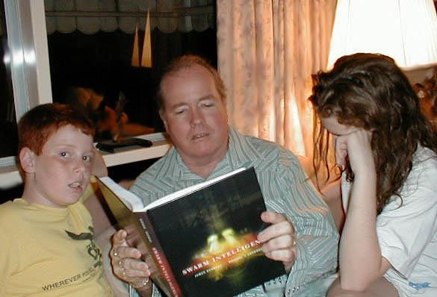
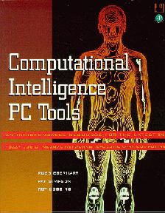



Classical and standard PSO
Russ Eberhart
James Kennedy

Slide 5
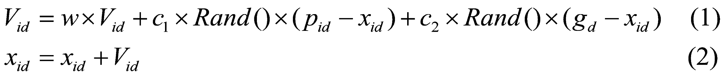
Classical
V_{id} : Velocity of each particle in each dimension
i: Particle
D: Dimension
W : Inertia Weight
c₁、c₂ : Constants
Rand() : Random
P_{id} : Best position of each particle
g_{d} : Best position of swarm
x_{id} : Current position of each particle in each dimension

Slide 6
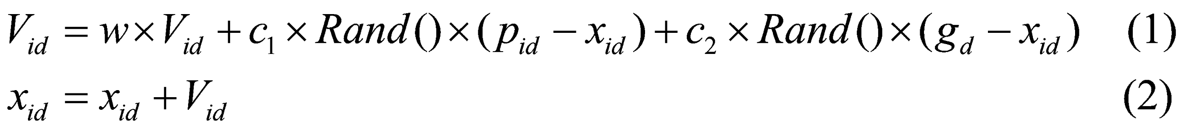
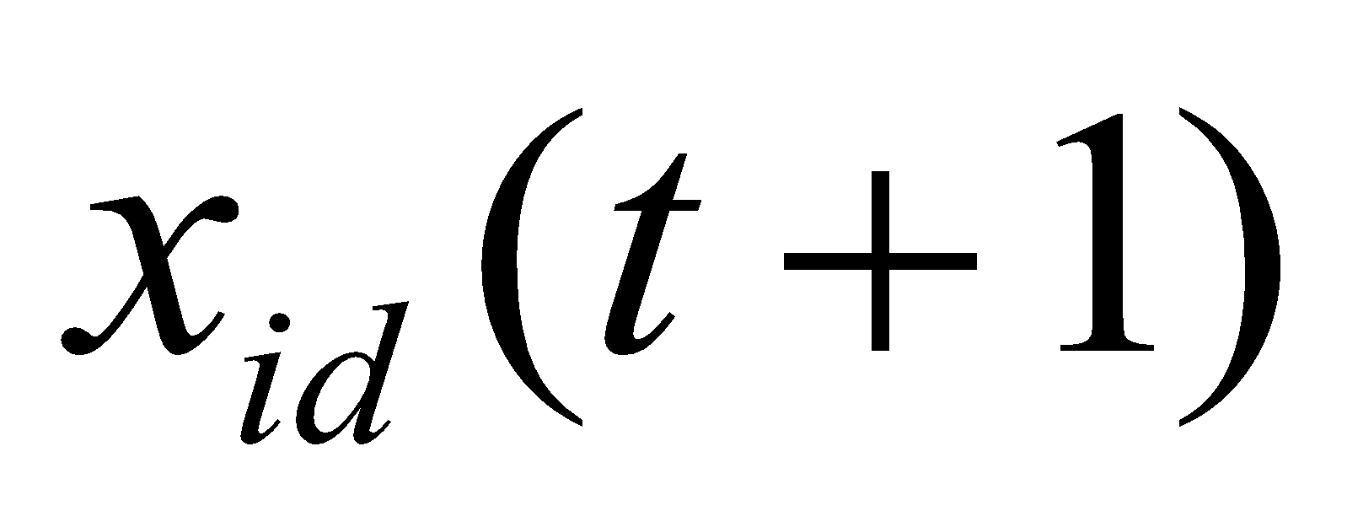
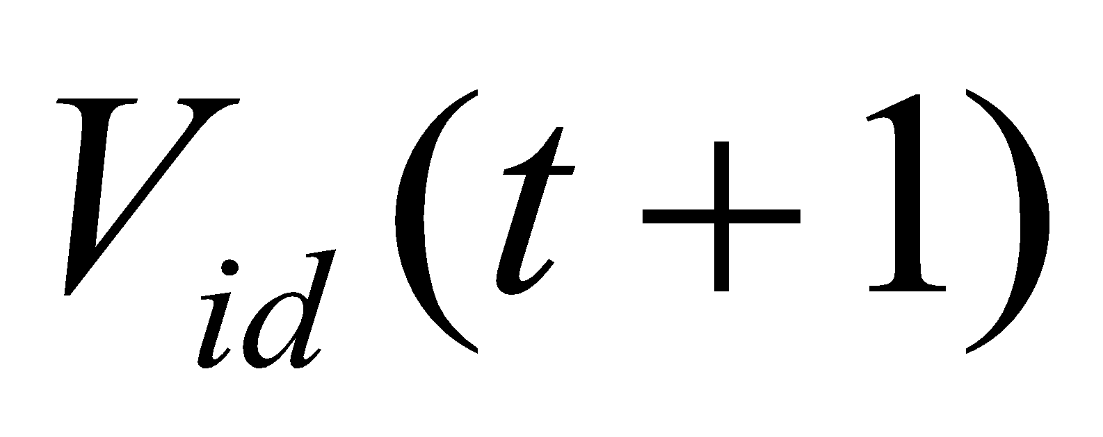
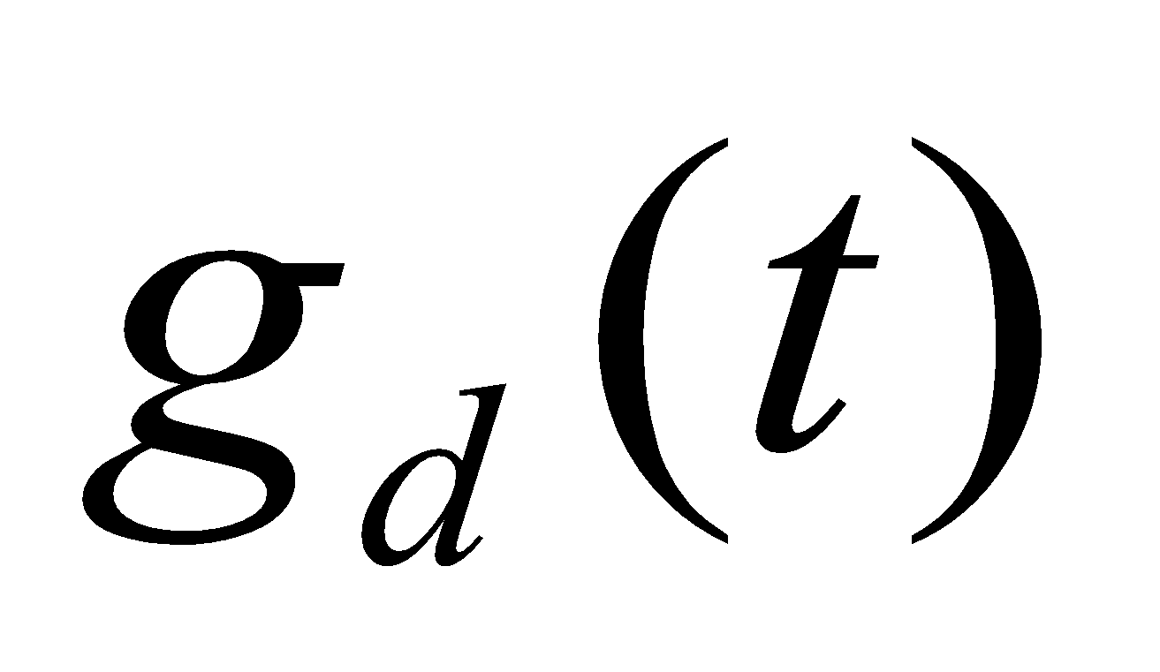
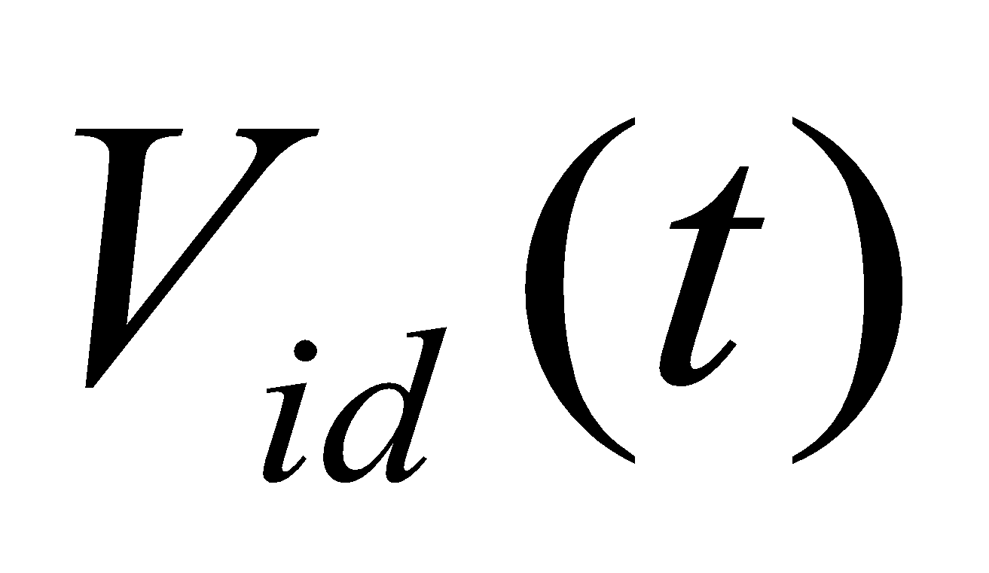
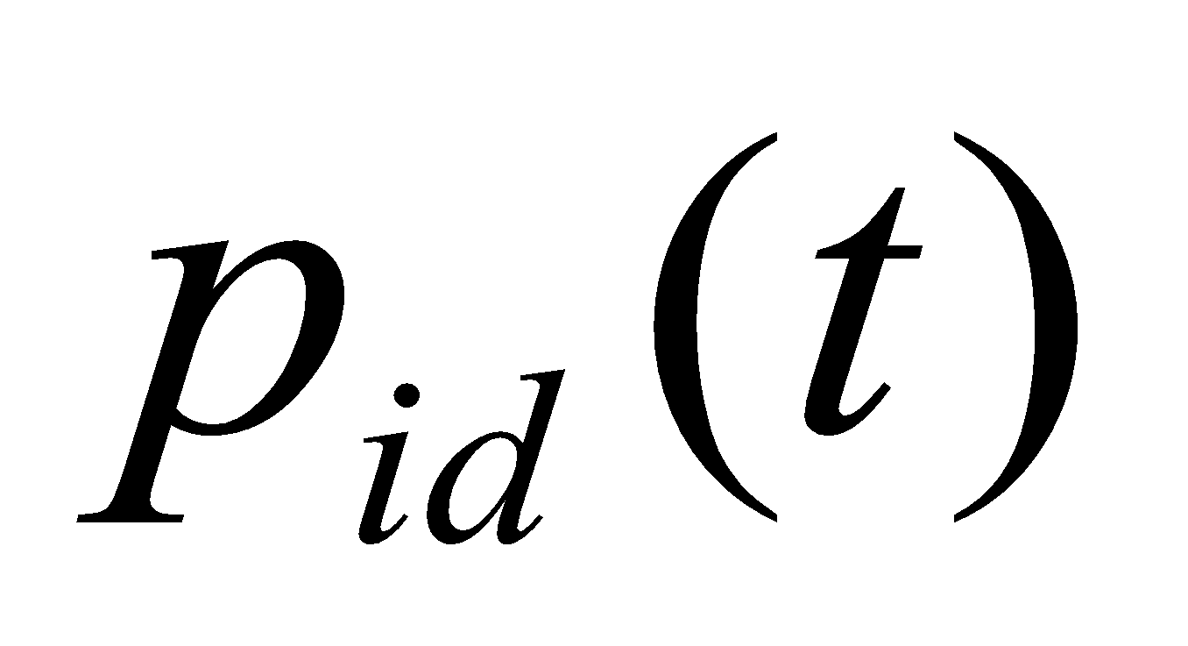
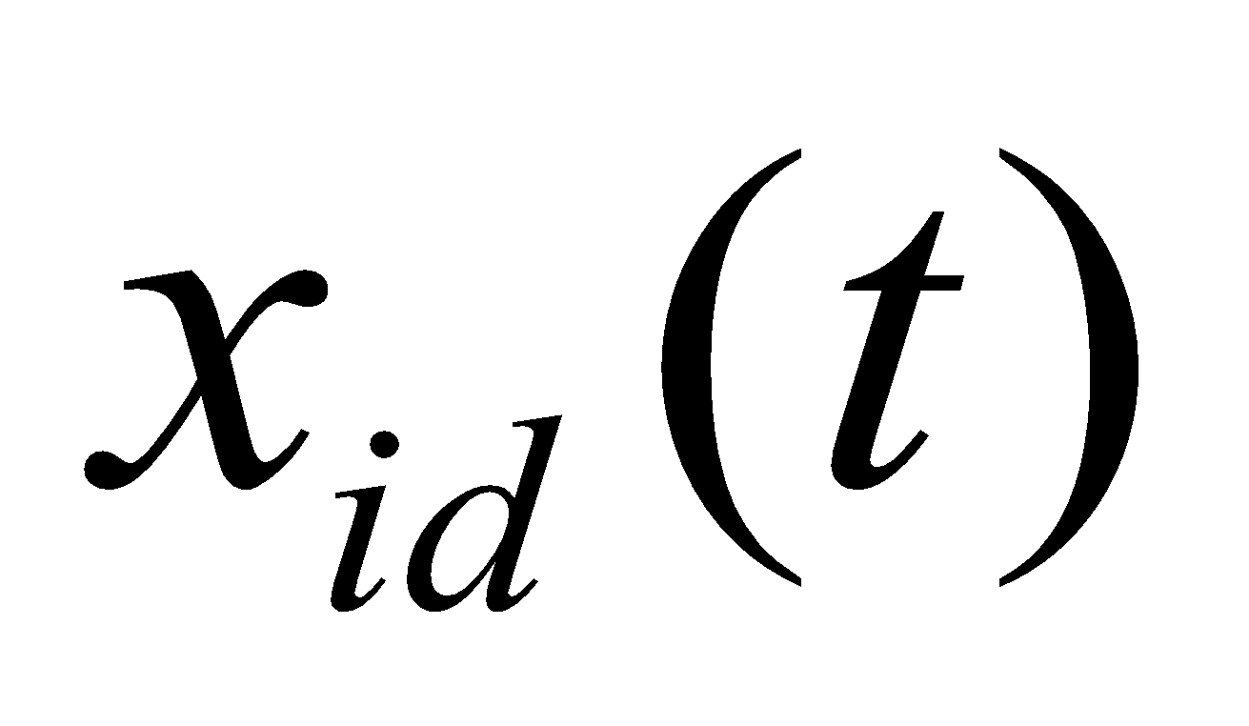
Classical and standard PSO
y
x

Slide 7
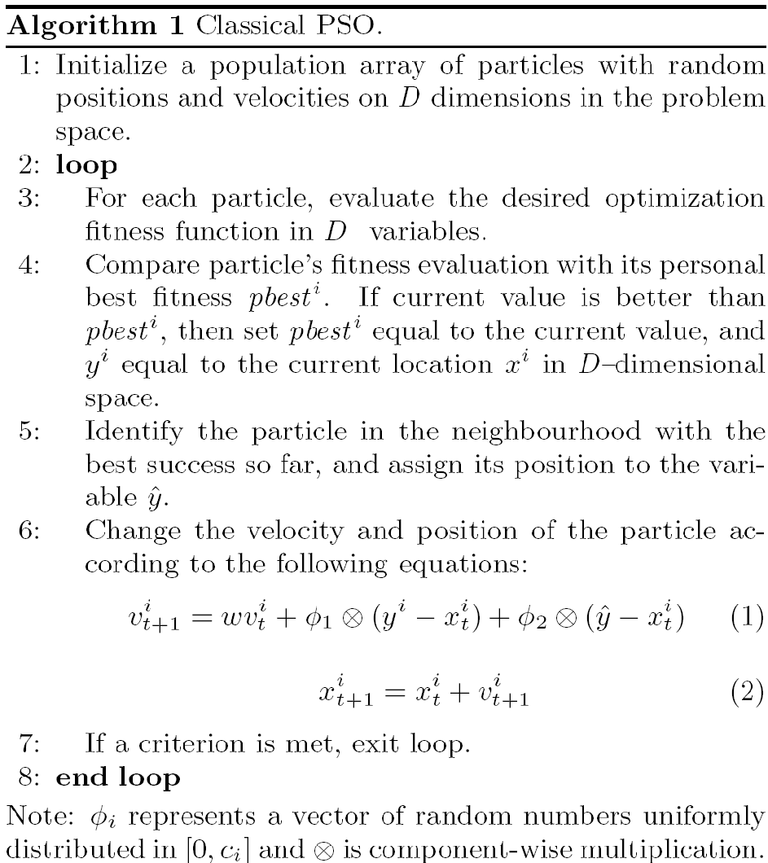
Flow chart depicting the General PSO Algorithm:

Slide 8
simulation 1
max
y
min
fitness
x
search space

Slide 9
simulation 2
max
y
min
fitness
x
search space

Slide 10
simulation 3
max
y
min
fitness
x
search space

Slide 11
simulation 4
max
y
min
fitness
x
search space

Slide 12
simulation 5
max
y
min
fitness
x
search space

Slide 13
simulation 6
max
y
min
fitness
x
search space

Slide 14
simulation 7
max
y
min
fitness
x
search space

Slide 15
simulation 8
max
y
min
fitness
x
search space

Slide 16
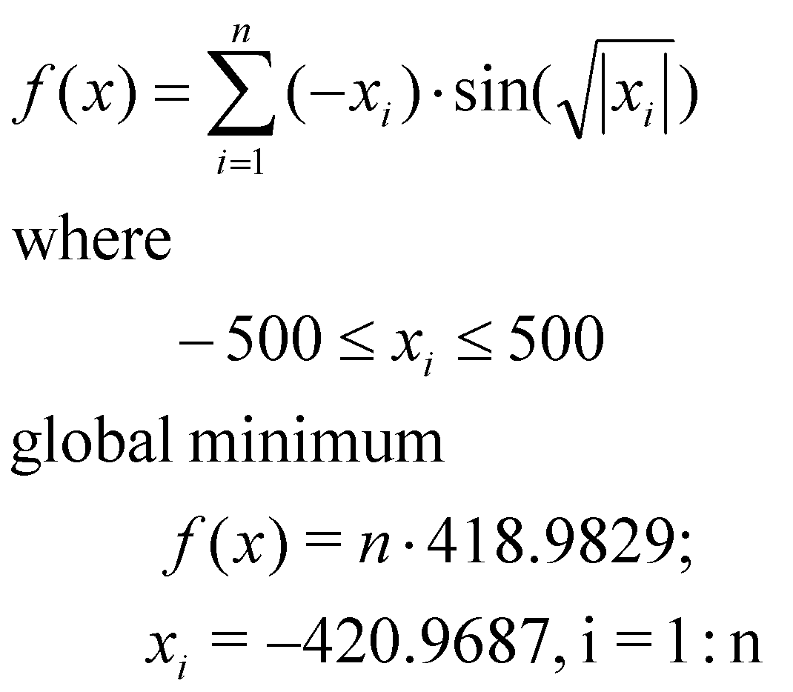
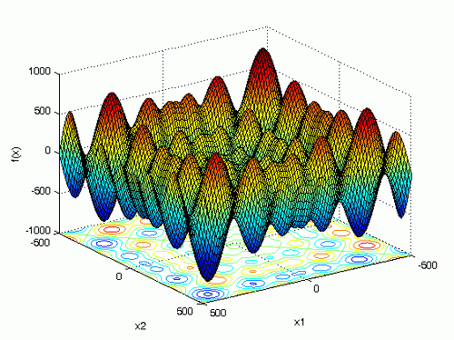
Schwefel's function

Slide 17
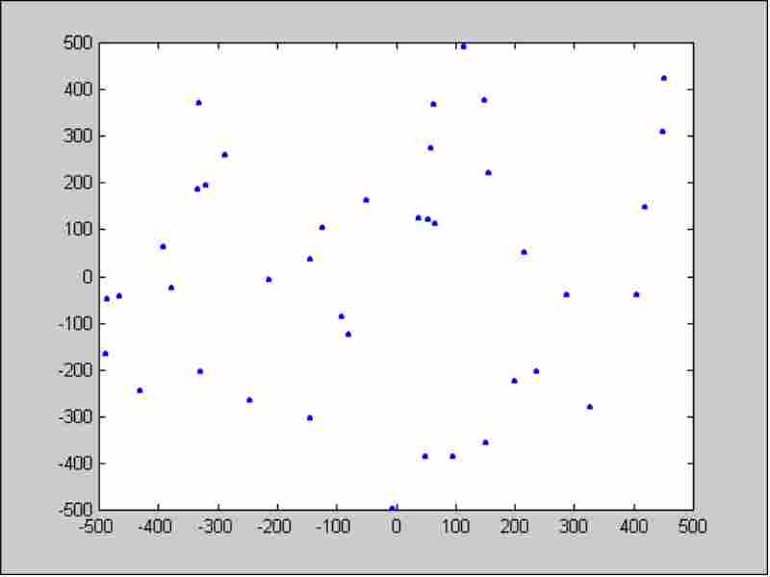
Evolution－Initialization

Slide 18
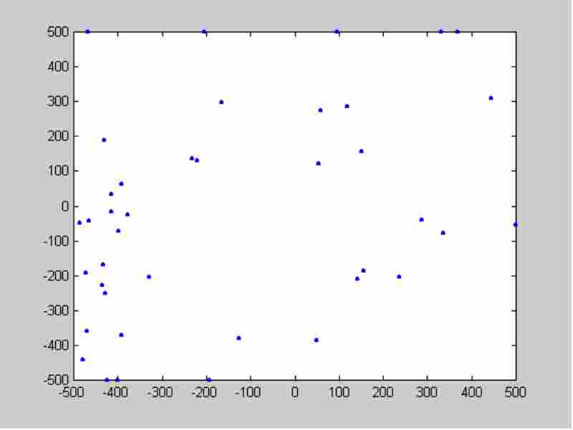
Evolution－5 iteration

Slide 19
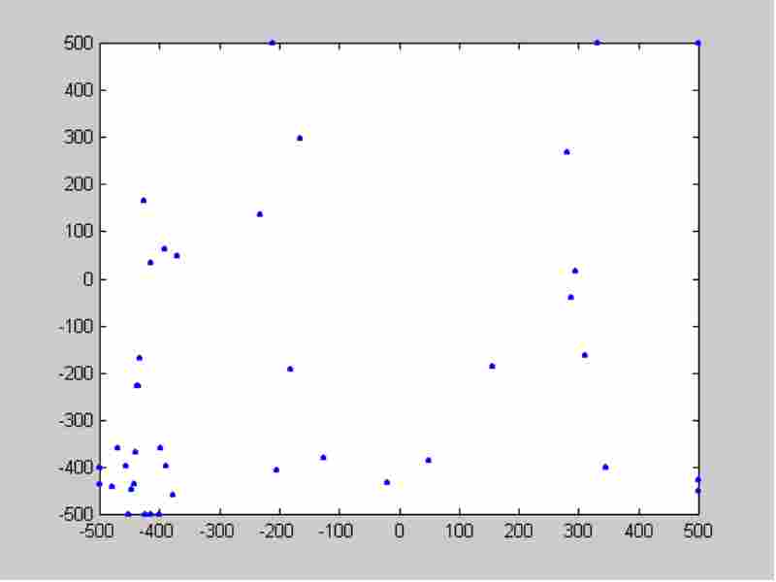
Evolution－10 iteration

Slide 20
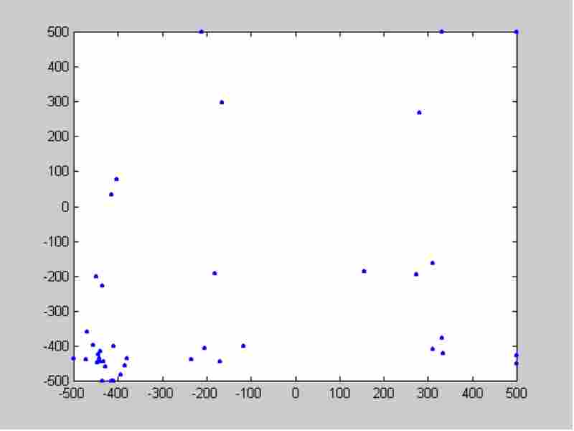
Evolution－15 iteration

Slide 21
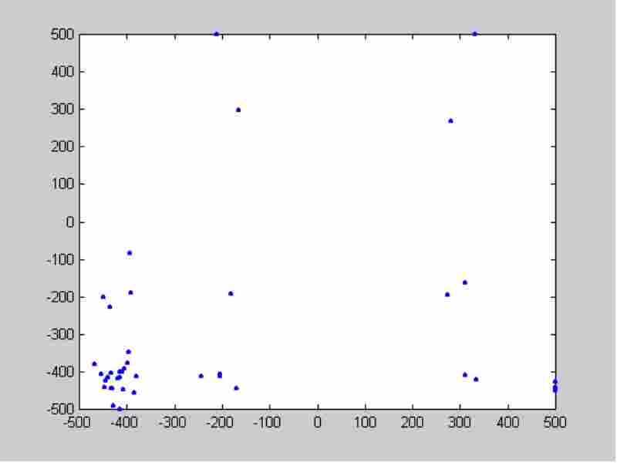
Evolution－20 iteration

Slide 22
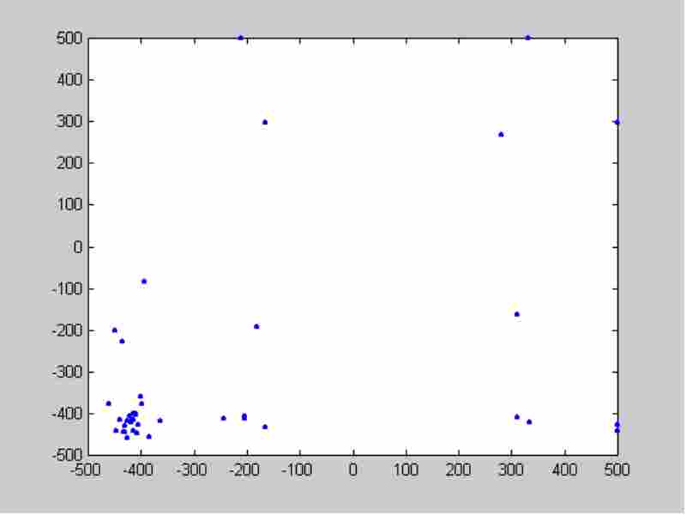
Evolution－25 iteration

Slide 23
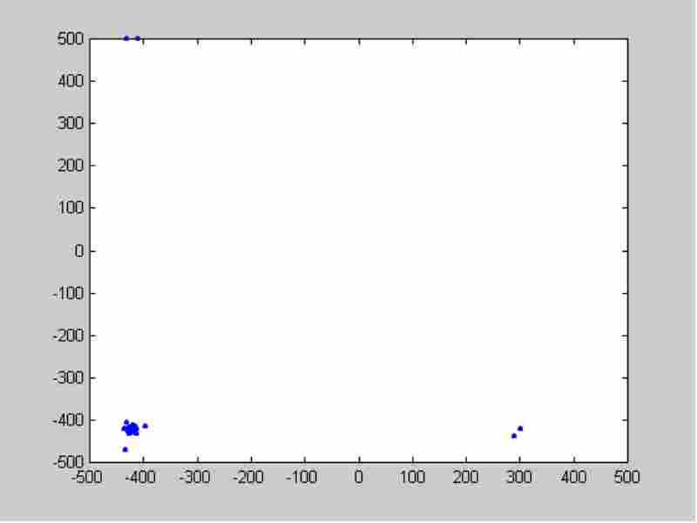
Evolution－100 iteration

Slide 24
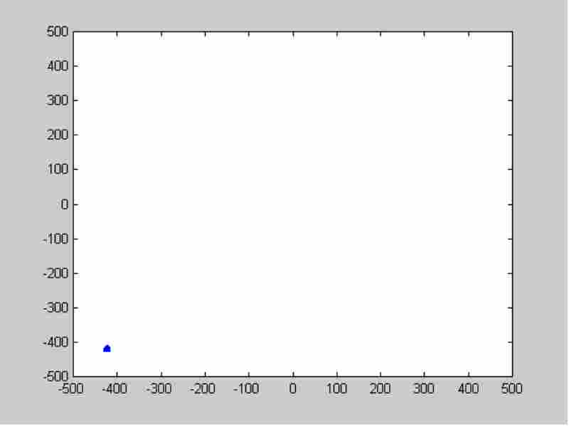
Evolution－500 iteration

Slide 25
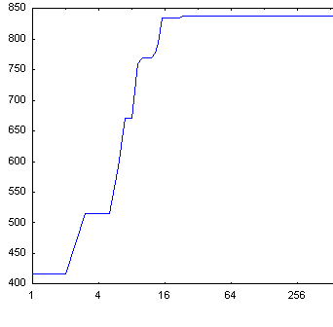
Search result
Iteration | Swarm best
0 | 416.245599
5 | 515.748796
10 | 759.404006
15 | 793.732019
20 | 834.813763
100 | 837.911535
5000 | 837.965771
Global | 837.9658

Slide 26

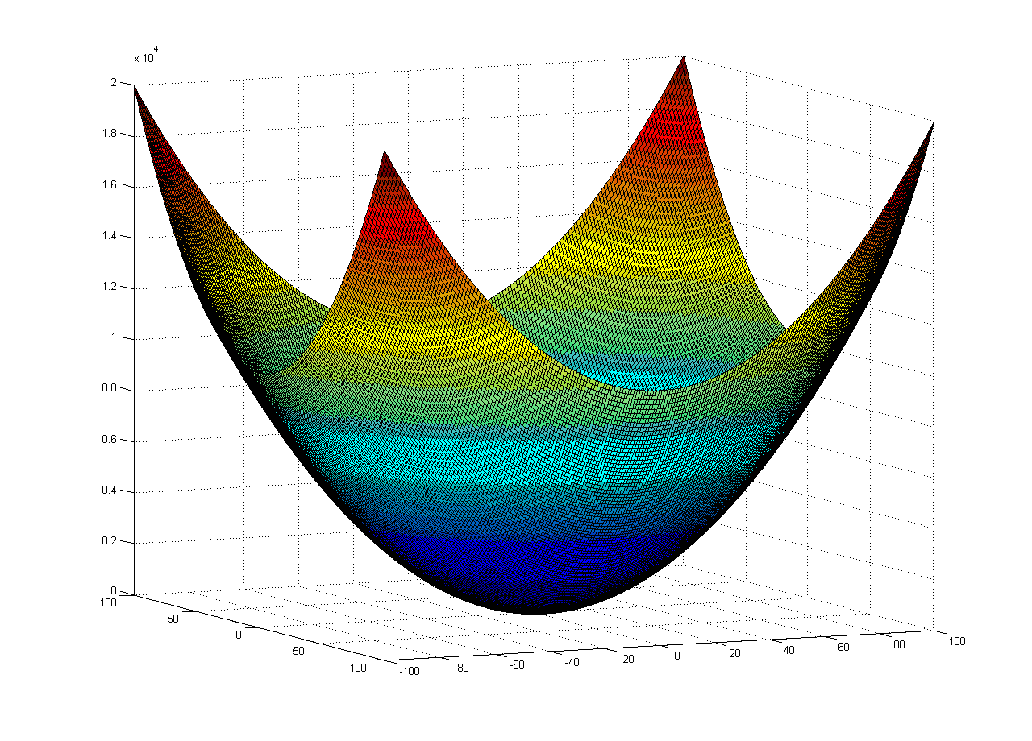
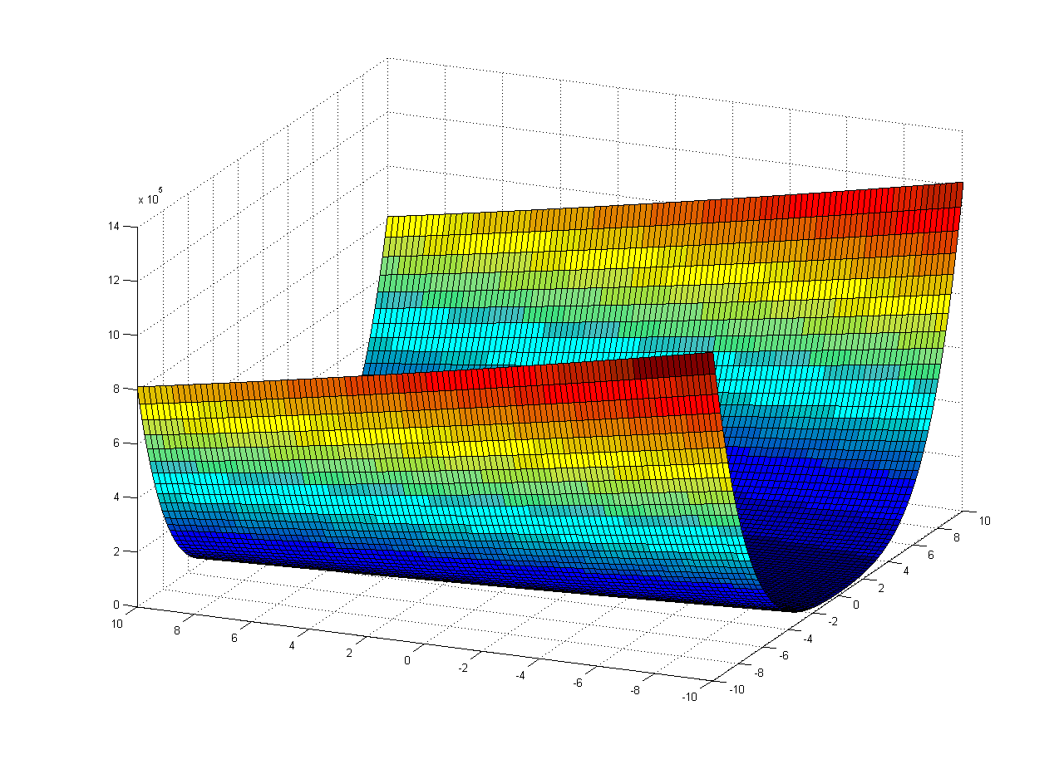
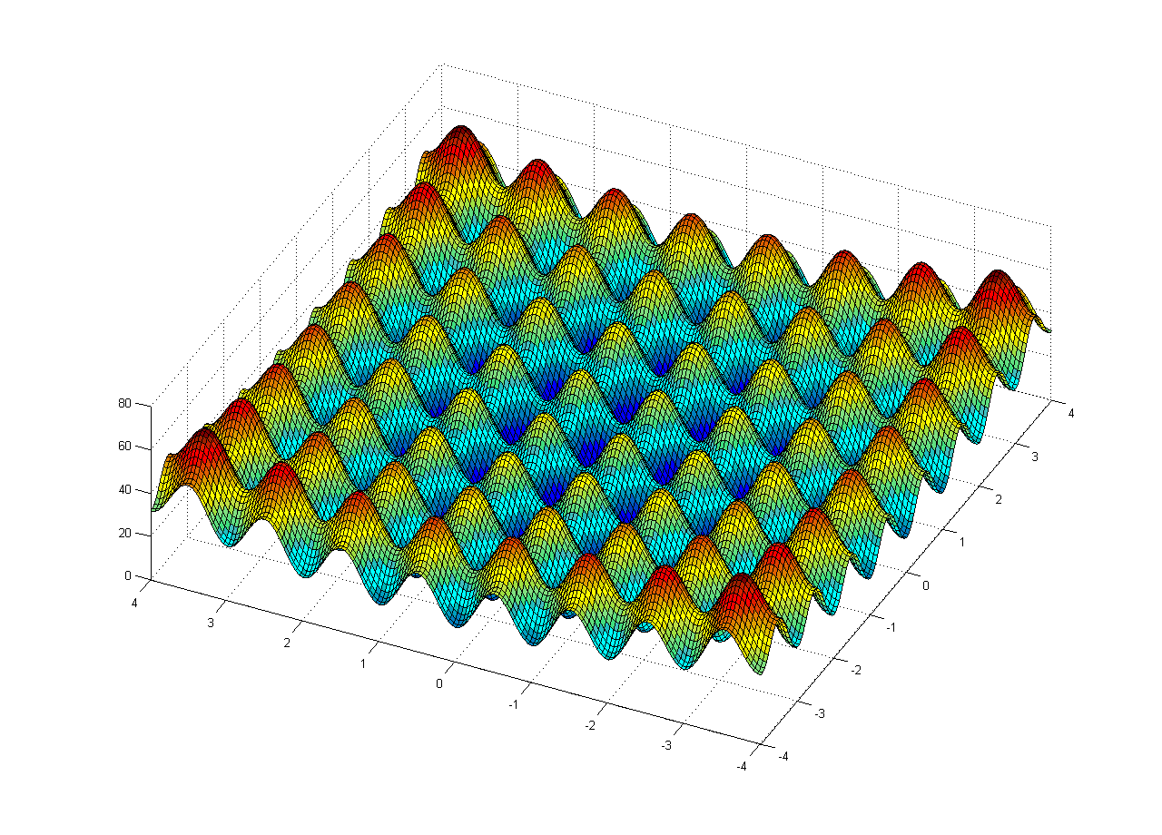
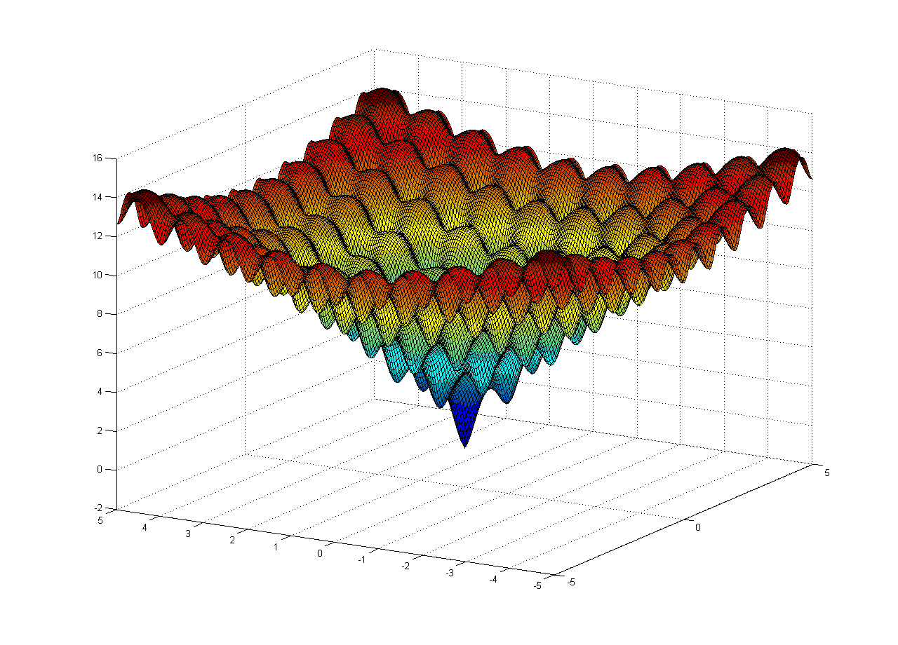
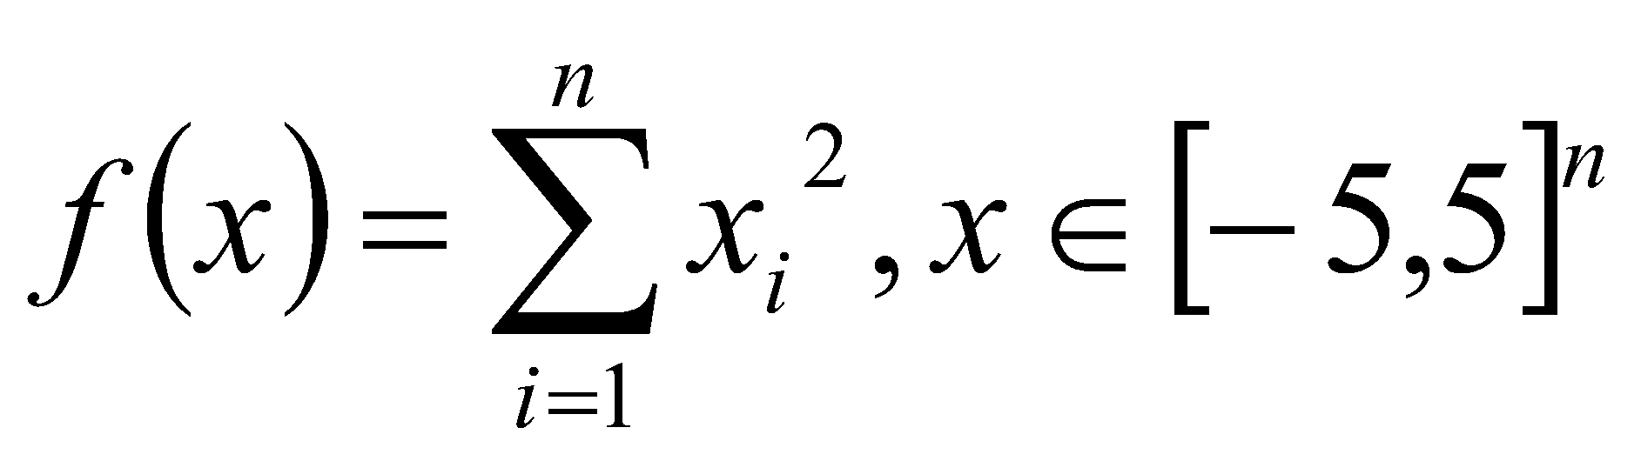
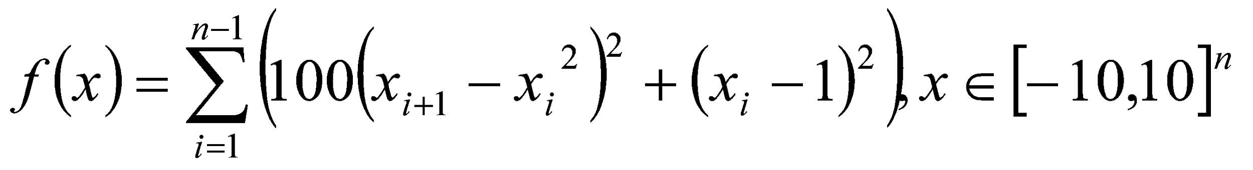
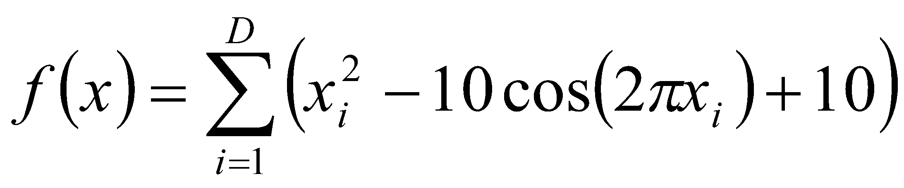
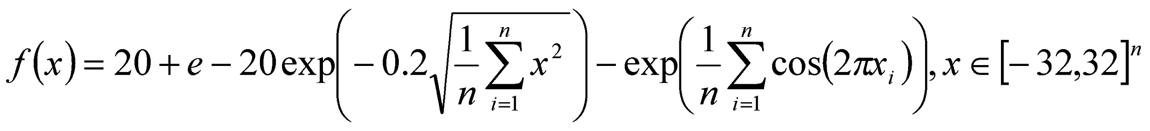
Standard benchmark functions
1）Sphere Function
2）Rosenbrock Function
3）Rastrigin Function
4）Ackley Function

Slide 27
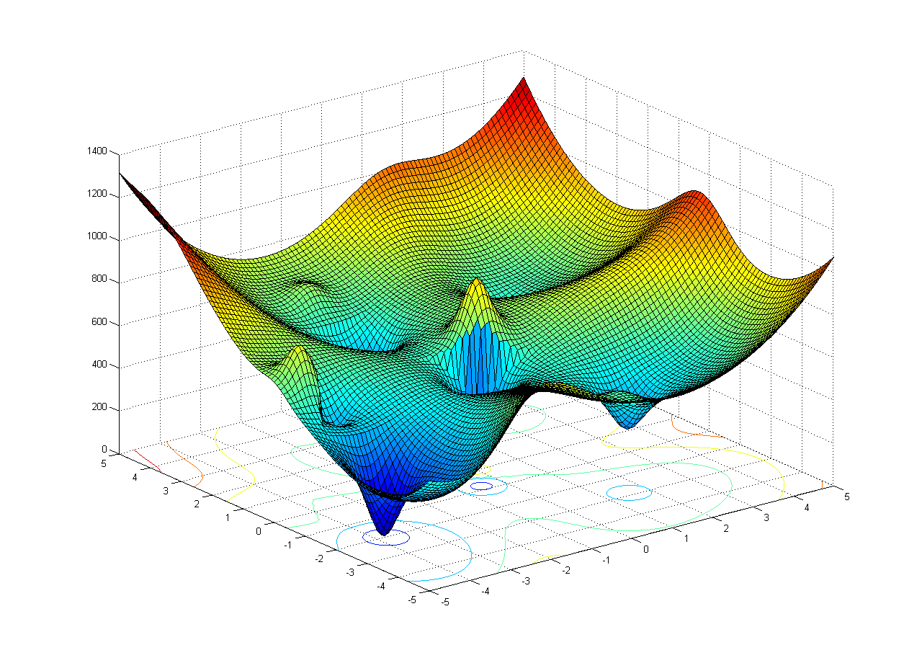
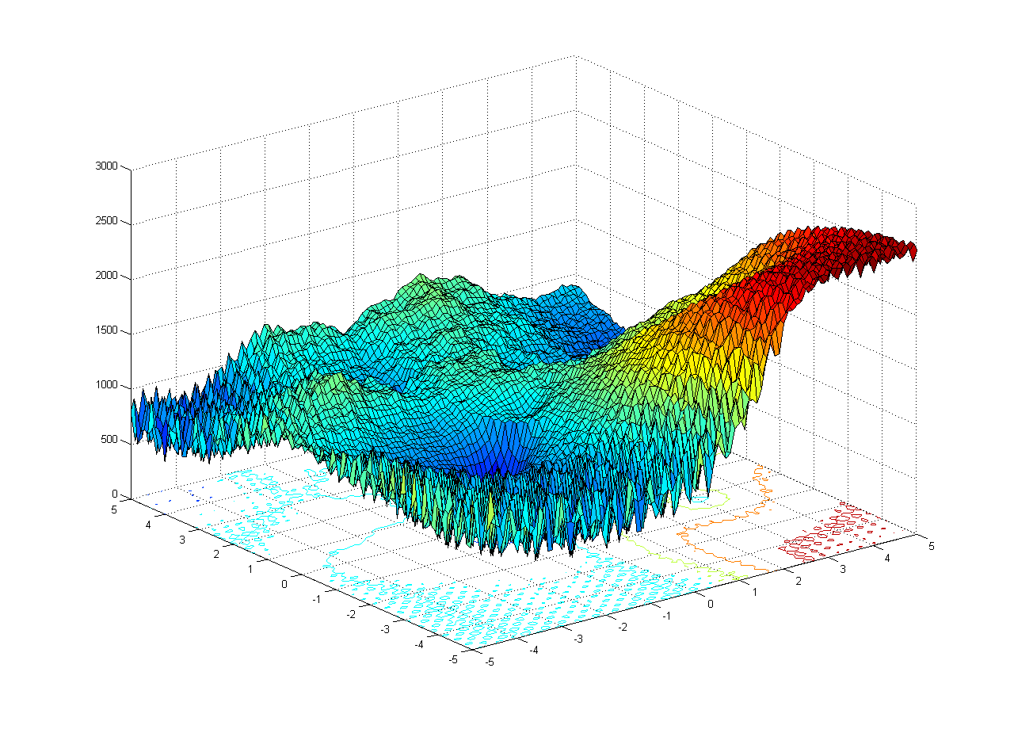
Composition Function

Slide 28
Analysis of PSO_state of art
Stagnation - Convergence
Clerc 2002
The particle swarm - explosion, stability, and convergence in a multidimensional complex space,2002
Kennedy 2005
Dynamic-Probabilistic Particle Swarms,2005
Poli 2007
Exact Analysis of the Sampling Distribution for the Canonical Particle Swarm Optimiser and its Convergence during Stagnation,2007
On the Moments of the Sampling Distribution of Particle Swarm Optimisers,2007
Markov Chain Models of Bare-Bones Particle Swarm Optimizers,2007
standard PSO
Defining a Standard for Particle Swarm Optimization,2007

Slide 29
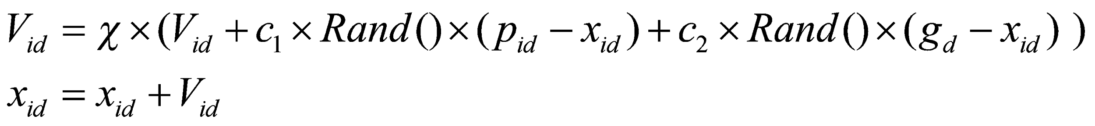

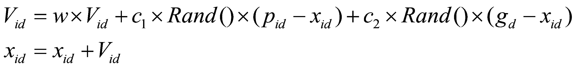
Analysis of PSO_state of art
standard PSO: constriction factor - convergence
Update formula
Equivalent

Slide 30
Analysis of PSO_state of art
standard PSO
50 particles
Non-uniform initialization
No evaluation when particle is out of boundary

Slide 31
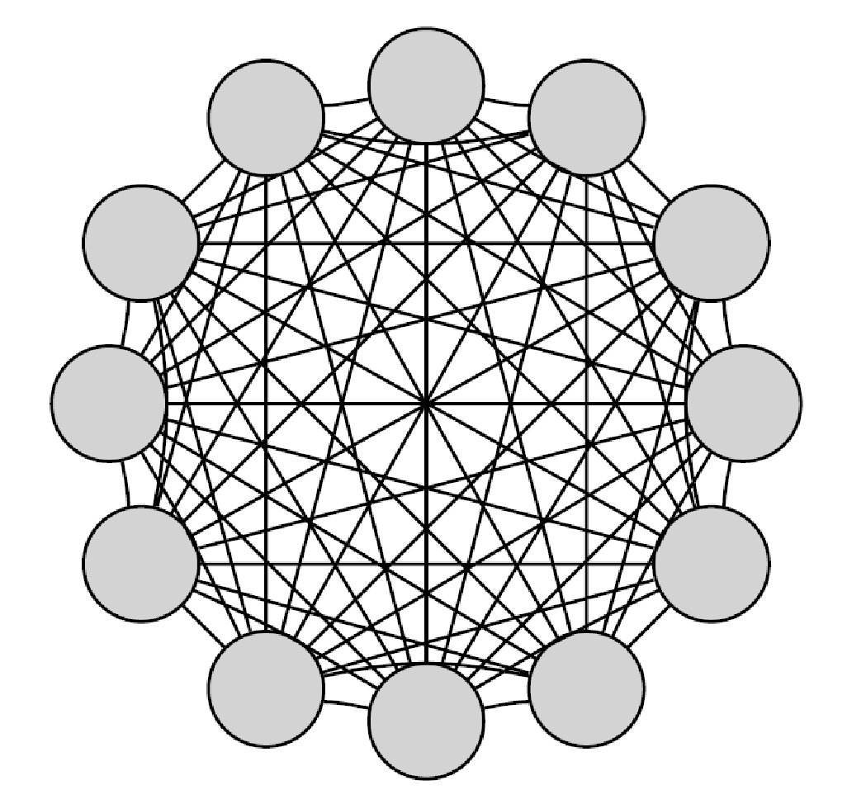
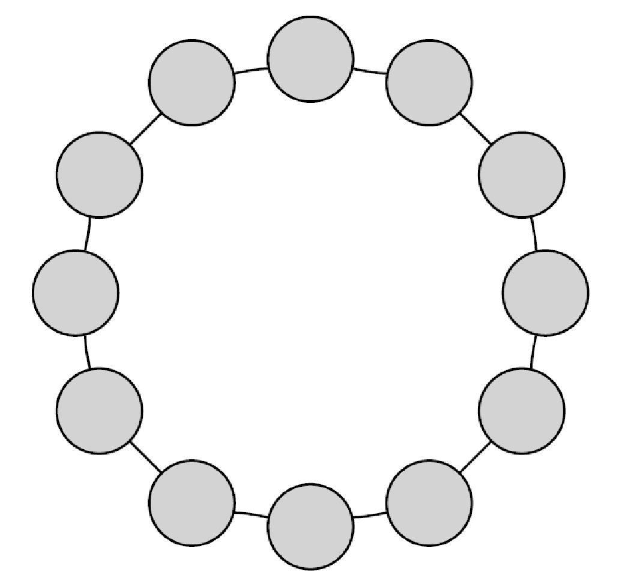
Analysis of PSO_state of art
standard PSO
A local ring topology

Slide 32
Analysis of PSO_state of art
How does PSO works?
Stagnation versus objective function
Classical PSO versus Standard PSO
Search strategy versus performance

Slide 33

Classical PSO
Main idea: Particle swarm optimization,1995
Exploit the current best position
Pbest
Gbest
Explore the unkown space

Slide 34
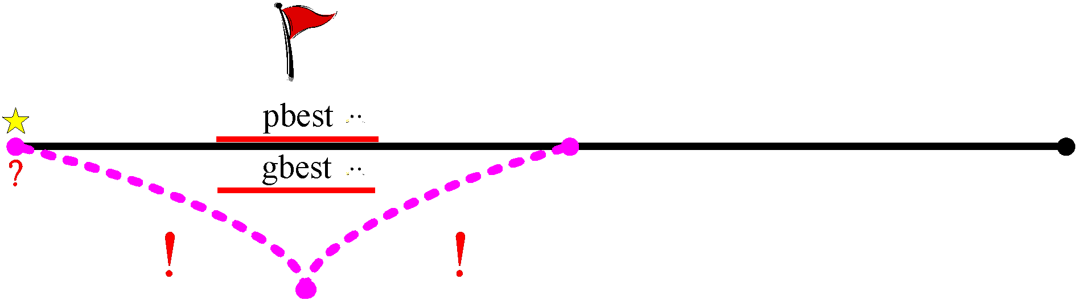
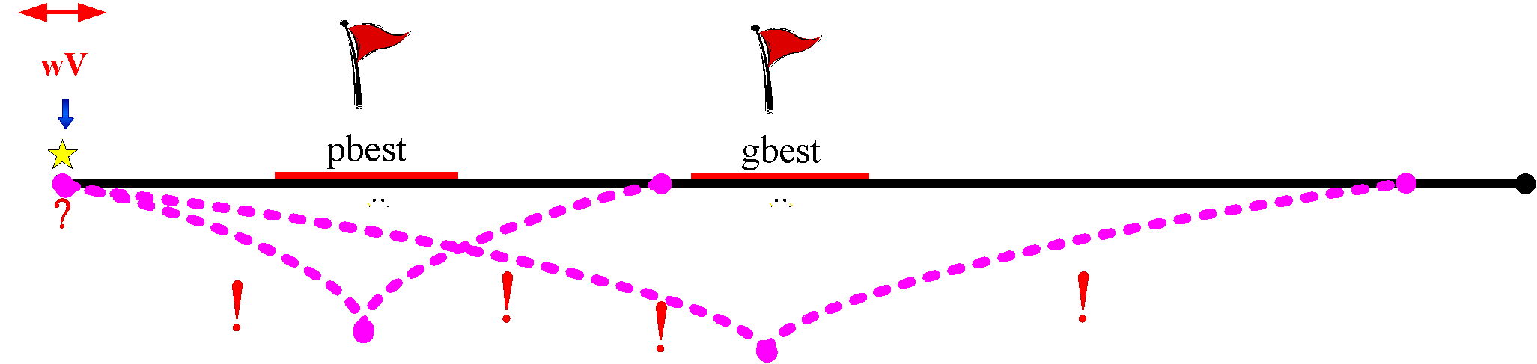
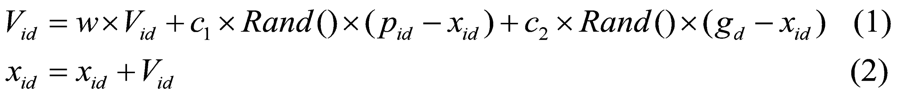
Classical PSO
Implementation

Slide 35
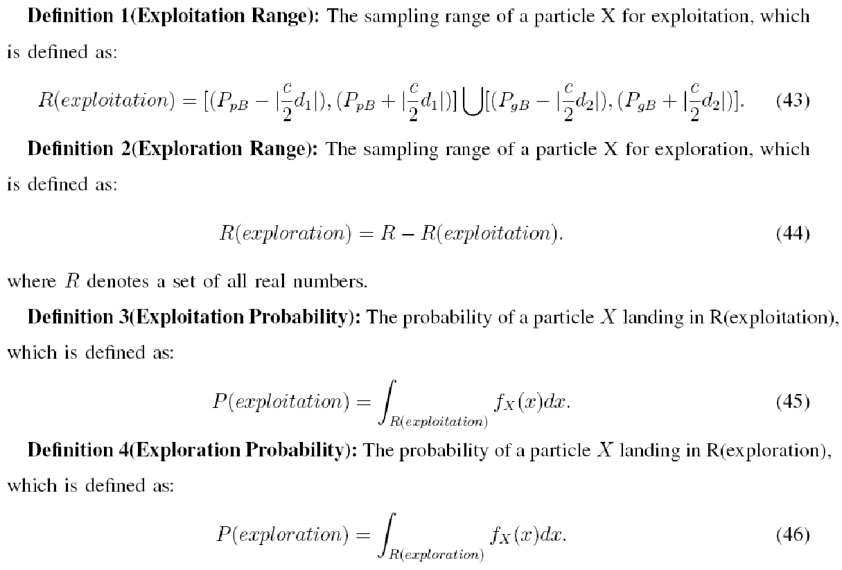
Analysis of PSO_our idea
Search strategy of PSO
Exploitation
Exploration

Slide 36
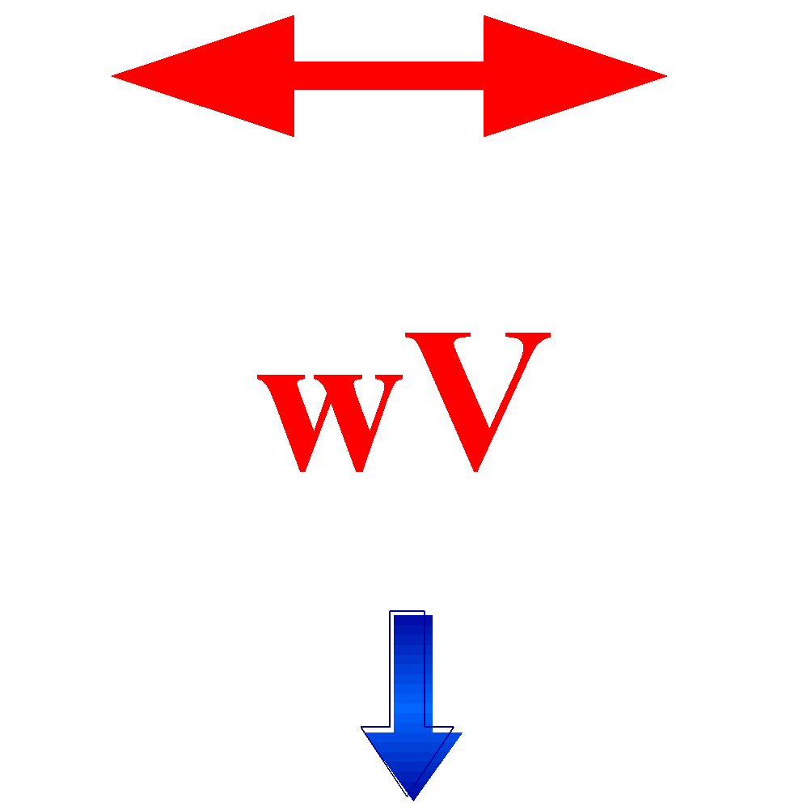
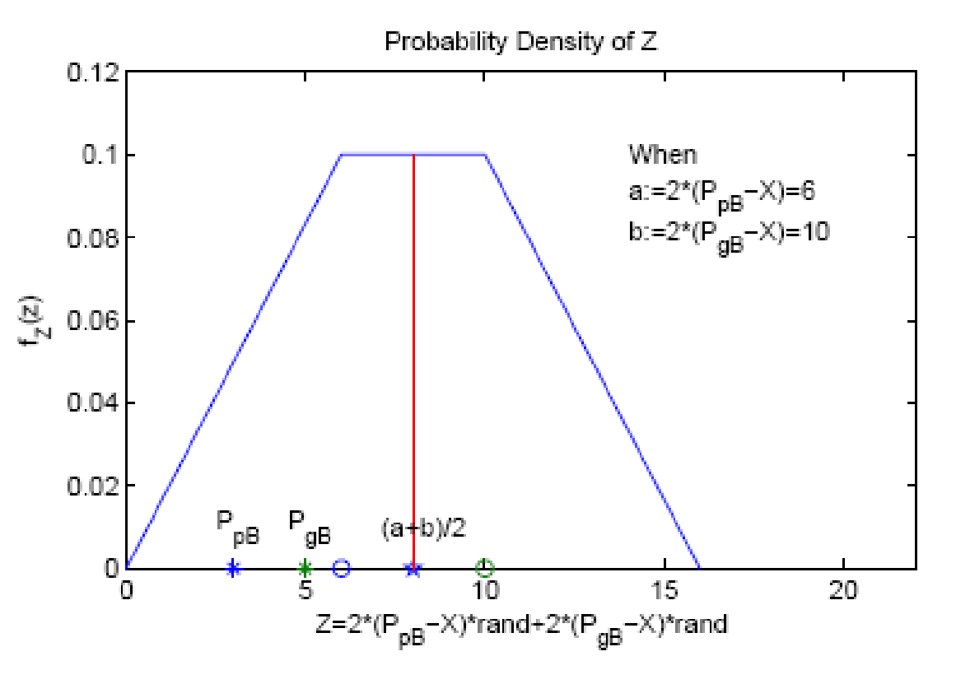

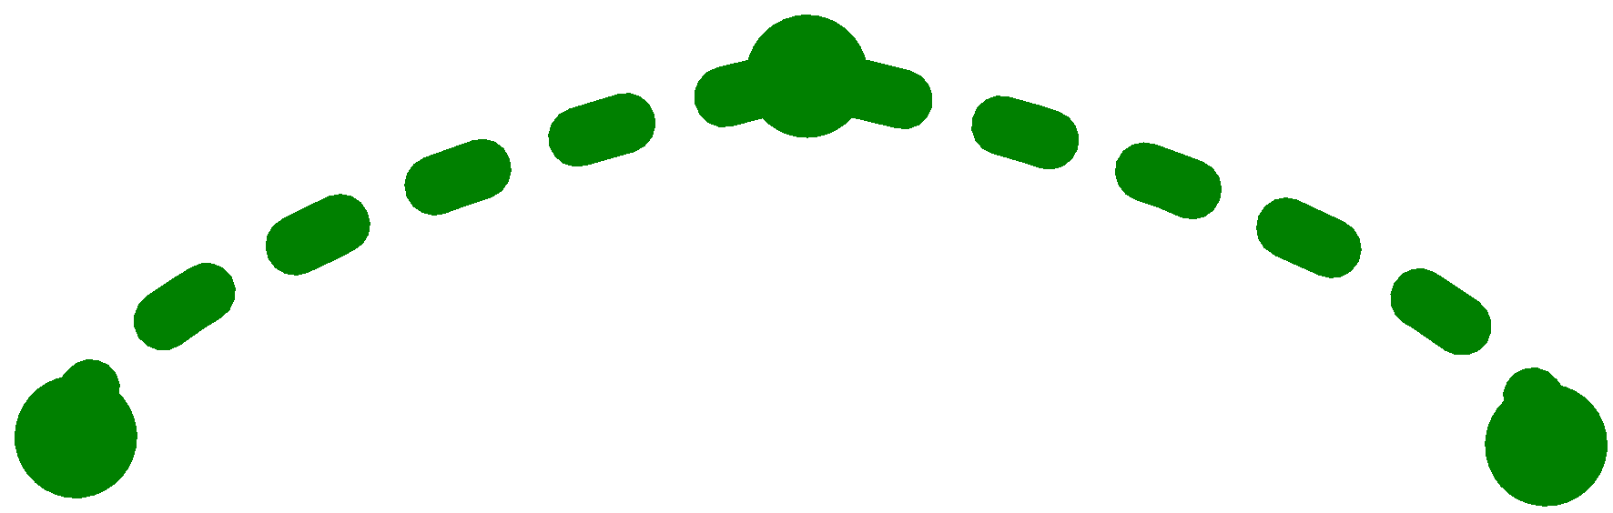
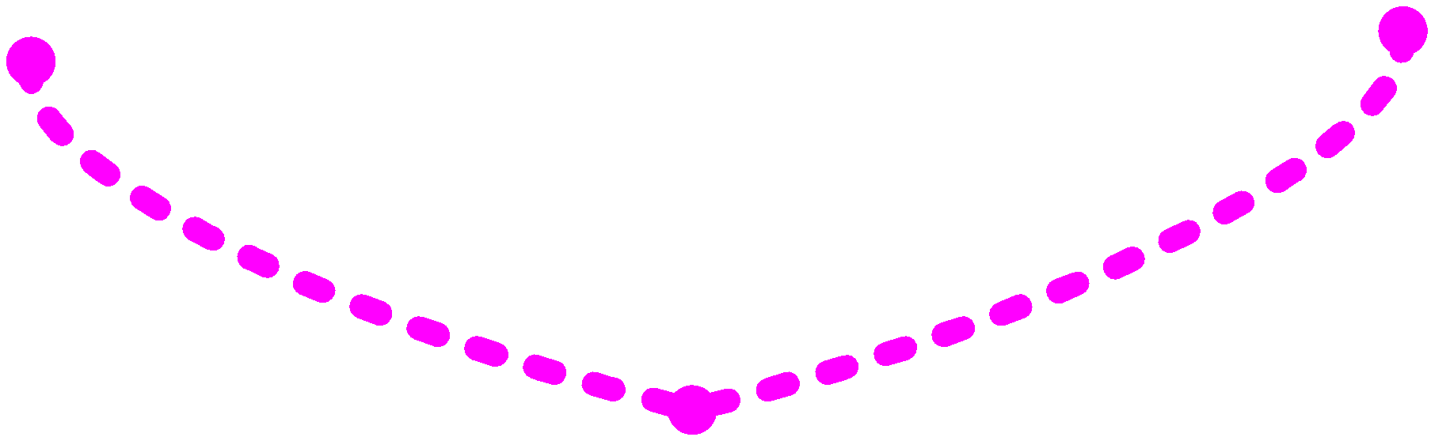
Analysis of PSO_our idea
Hybrid uniform distribution
Exploitation
Exploration

Slide 37
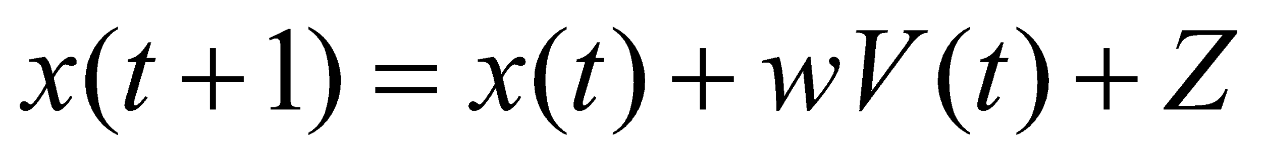
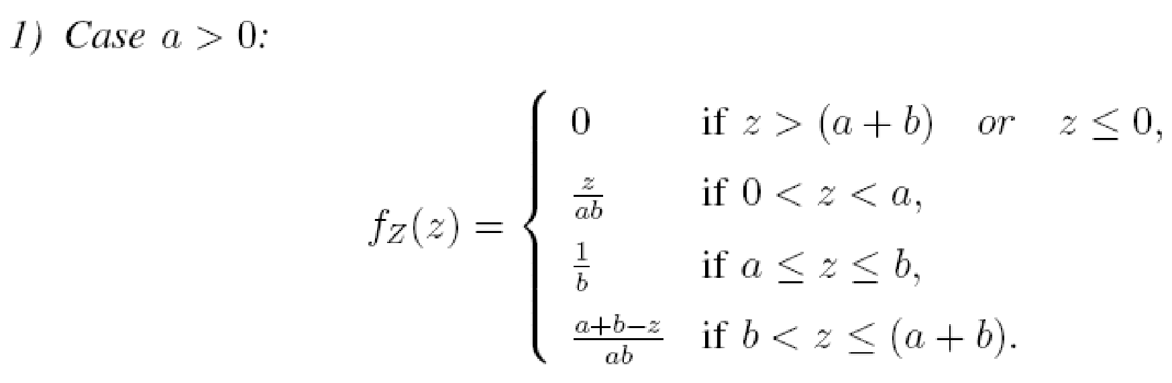
Analysis of PSO_our idea
Sampling probability density-computable

Slide 38
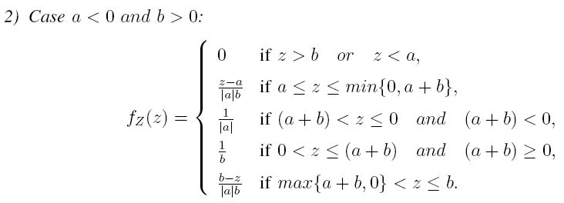
Analysis of PSO_our idea

Slide 39
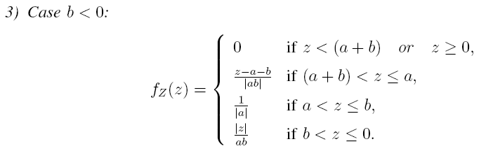
Analysis of PSO_our idea

Slide 40
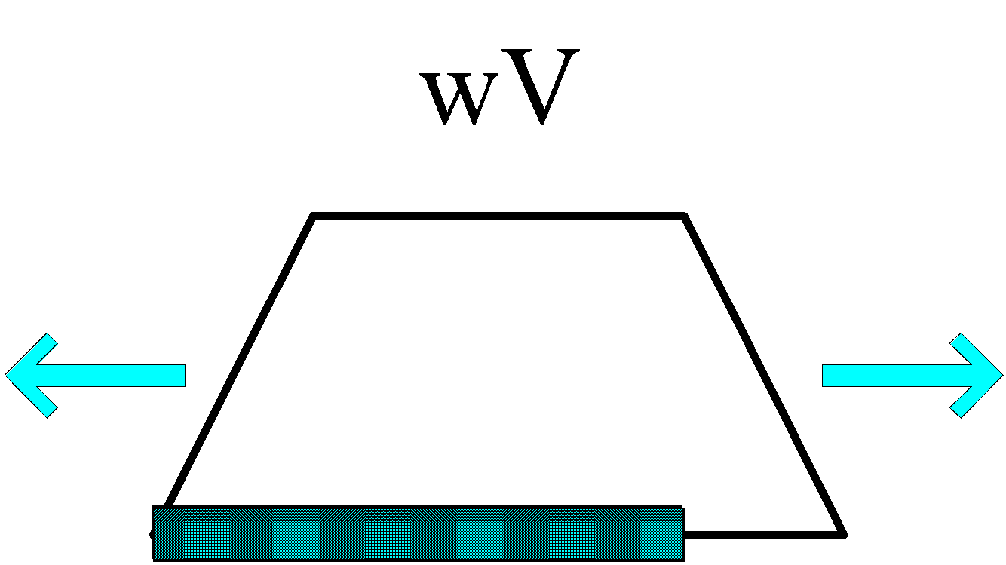



Analysis of PSO_our idea
Sampling probability

Slide 41

Analysis of PSO_our idea
No inertia part(wV)

Slide 42

Analysis of PSO_our idea
Inertia part(wV)

Slide 43

Analysis of PSO_our idea
No inertia part(wV)

Slide 44

Analysis of PSO_our idea
Inertia part(wV)

Slide 45
Analysis of PSO_our idea
Difference among variants of PSO
Exploitation
Exploration
Probability
Balance

Slide 46


Analysis of PSO_our idea
What is the property of the iteration?

Slide 47
Analysis of PSO_our idea
Whether the search strategy is the same or whether the PSO is adaptive when
Same parameter(during the convergent process)
Different parameter
Different dimensions
Different number of particles
Different topology
Different objective functions
In different search phase(when slow or sharp slope,stagnation,etc)
What’s the change pattern of the search strategy?

Slide 48
Analysis of PSO_our idea
What is the better PSO on the search strategy?
Simpler implement
Using one parameter as a tuning knob instead of two in standard PSO
Prove they are equialent when setting some value of parameter
Effective on most objective functions
Adaptive

Slide 49
Analysis of PSO_our idea
Markov chain
State transition matrix

Slide 50





Analysis of PSO_our idea
Random process
Gaussian process
Kernel mapping

Slide 51
Analysis of PSO_our idea
the object of our analysis
search strategy of PSO
Different parameter sets
In different dimensions
Using different number of particles
On different objective functions
Fitness evaluation
Different topology
Markov or gauss process and kernel function
Direction to PSO
Knob PSO

Slide 52

Analysis of PSO_our idea

Slide 53

Current results
Variance with convergence
func_num=1;
fes_num=5000;
run_num=10;
particles_num=50;
dims_num=30;

Slide 54

Current results
Variance with dimensions
func_num=1;
fes_num=3000;
run_num=10;
particles_num=50;

Slide 55

Current results
Variance with number of particles
func_num=1;
fes_num=3000;
run_num=10;
dims_num=30;

Slide 56
Current results
Variance with topology

Slide 57
Current results
Variance with inertia weight

Slide 58


Current results
1. Shifted Sphere Function
2. Shifted Schwefel's Problem 1.2

Slide 59


PSO on Benchmark Function
3. Shifted Rotated High Conditioned Elliptic Function
4. Shifted Schwefel's Problem 1.2 with Noise in Fitness

Slide 60
Current results
Variance with objective functions
Unimodal Functions
Multimodal Functions
Expanded Multimodal Functions
Hybrid Composition Functions

Slide 61

Current results
Variance with objective functions
func_num=1,2,3,4;
fes_num=3000;
run_num=5;
particles_num=50;
dims_num=30;

Slide 62
variants of PSO_state of art
Traditional strategy
Simulated annealing
Tabu strategy
Gradient methods
Adopted from other fields
Clonal operation
Mutation operation
Heuristical Methods
Advance and retreat
Structure topology
Full connection
Ring topology

Slide 63
Our variants of PSO
CPSO
AR-CPSO
MPSO
RBH-PSO
FPSO

Slide 64





Our variants of PSO
CPSO

Slide 65


Our variants of PSO
MPSO

Slide 66


Our variants of PSO
AR-CPSO

Slide 67


Our variants of PSO
FPSO

Slide 68

Applications of PSO

Slide 69


Applications of PSO

Slide 70

Applications of PSO

